Slide 1
Marathon County Zoning Informational Meeting Town of Cleveland January 10th, 2023
Shad Harvey (Land Resources Manager), Garrett Pagel (Land Use Specialist)
Marathon County Conservation, Planning, and Zoning

Slide 2
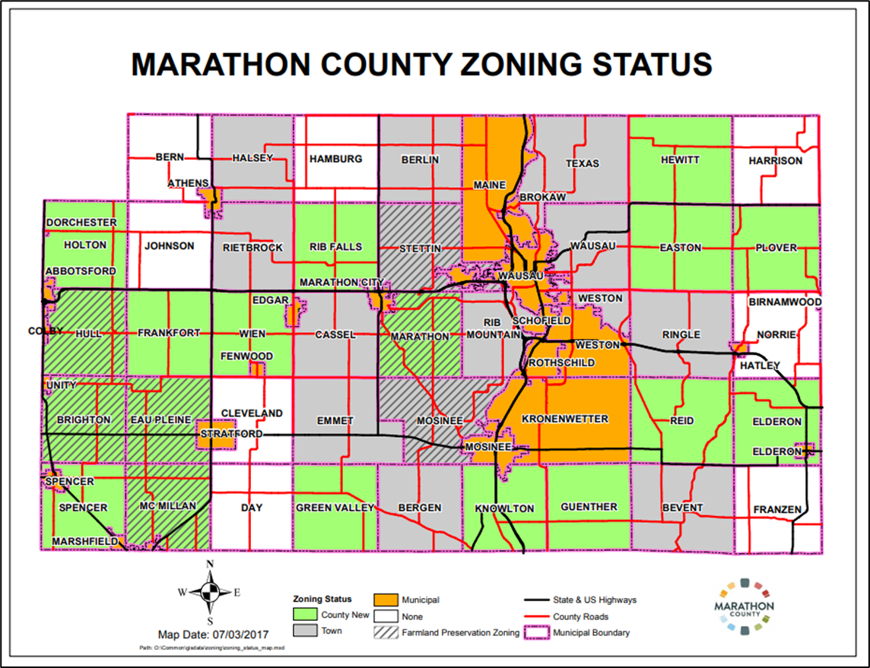

Slide 3
Why do we have zoning?
It is ONE of the tools to help communities achieve the goals identified in their comprehensive plan.
Zoning also helps protect the interests of the individual property owner through uniform application of Marathon County Chapter 17 Zoning Ordinance.

Slide 4
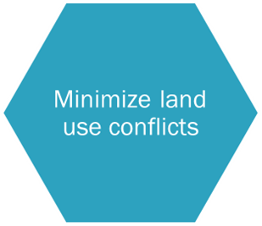
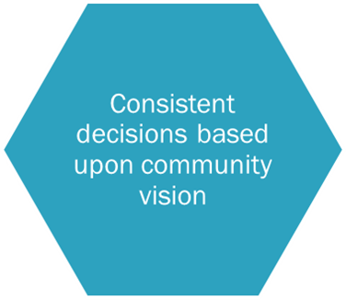
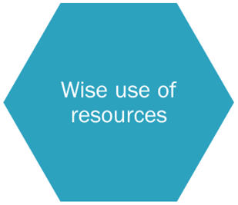
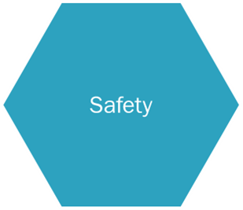
Benefits of County Zoning
Promotes the health, safety, and prosperity for all.

Slide 5
Benefits of County Zoning (cont.)
The county enforces the ordinance with the help of the town.
When land use conflicts or violations arise, Marathon County staff pursue compliance using the Town Comprehensive Plan and Marathon County Chapter 17.
If compliance is refused by the property owner, Marathon County Corporation Counsel proceeds through the court system.
There is no cost to the town. This is already paid for through taxes.
Opens the door for some agricultural and tax benefits.
Can possibly slow the encroachment from urban areas into the town.
Farmland Preservation

Slide 6
Farmland Preservation
Two Paths to Participating:
FARMLAND PRESERVATION ZONING
A tool that helps promote agriculture, restrict non-agricultural land use in agricultural areas, and limit land use conflicts.
In a nutshell…Promote and preserve prime agricultural land. 35-acre minimum lot size.
Tax credits of $7.50/acre (no contract/requirement of long term commitment)
AGRICULTURAL ENTERPRISE AREA (AEA)
A locally led effort and designation that establishes an area as being important to the future of agriculture, and strives to support local farmland protection goals.
Not Zoning or Land Use Control
Like an “industrial park” for agriculture
Participation of at least 5 landowners per Town
Contiguous land area (can have “bridges”)
Eligibility to claim Farmland Preservation tax credits (15-year agreement/contract) for $5/acre

Slide 7
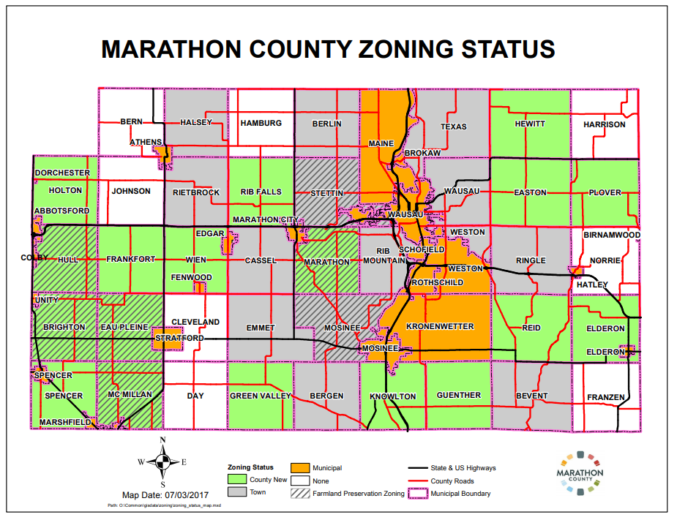
Farmland Preservation
Hull, Brighton, Eau Pleine, McMillan, Stettin, Marathon, Mosinee participate in FP Zoning

Slide 8
Creating a Partnership
The only way that County Zoning works is a partnership WITH the towns.
Town has the opportunity through the Comprehensive Plan writing and initial zoning map to choose the direction of their town.
Eyes and Ears of your town.
All rezones, conditional use, and variance applications are also sent to the towns for a resolution stating the town’s opinion on the application for consideration by the appropriate committee or board.
Board of Adjustment and Environmental Resources Committee

Slide 9
Comprehensive Plan
The Comprehensive Plan is truly the road map for what your town is and what it wants to be.
Guides the course of decision-making as it relates to land use and future development.
Plans change (ex. push from surrounding areas to expand, area needs, state and federal grants, etc.)
GUIDING decision document to town.

Slide 10
How do we get a Comprehensive Plan?
The creation of a Comprehensive Plan involves everyone from Town Board Officials, a Comprehensive Plan Committee dedicated to create the plan, citizen involvement/participation, and assistance from a professional planning team.
A professional planning team can assist the town navigate State requirements and timelines.
A planning team can provide technical guidance and services.

Slide 11
Comprehensive Zoning Revision
It shall be the County’s policy of providing an opportunity for Marathon County towns to reconsider and opt out of county zoning by conducting a comprehensive revision of this chapter at a minimum of ten-year intervals. Ten-year intervals shall ensure zoning code compliance with the county’s and town’s comprehensive plan revision in accordance with state statutes.

Slide 12
Comprehensive Zoning Revision (cont.)
Unique opportunity to join county zoning.
The next Comprehensive Revision is scheduled for 2026.
Allows for a 3-year trial period to test out county zoning.
If it works well for your town, we welcome you to stay in until the next comprehensive update in 2036.
If it does not, the town can opt out.

Slide 13
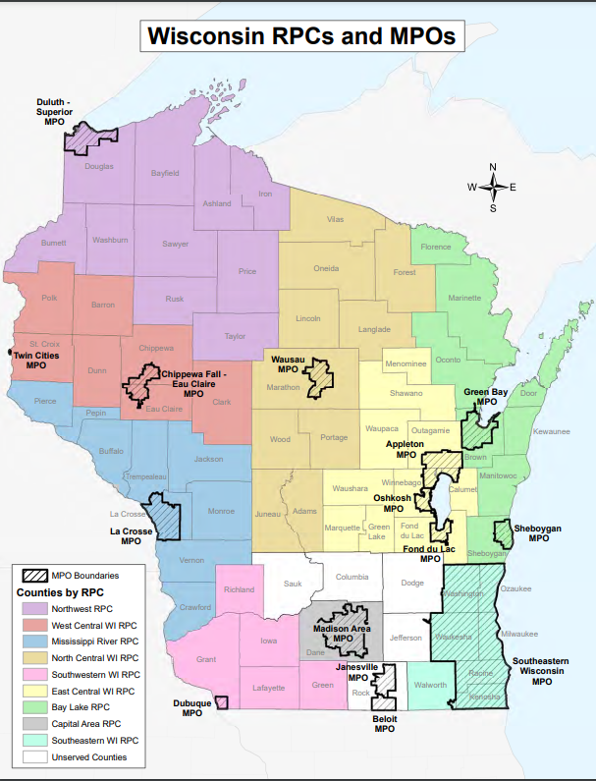
Ratifying of County Zoning
Create a comprehensive plan with assistance from the Regional Planning Commission.
Work with County to prepare zoning map.
Town adopts County Zoning in a Resolution.

Slide 14
Specific Concerns
CAFOs and Poultry Farms
Both are regulated by Marathon County’s Livestock Licensing and Animal Waste Ordinances. CAFOs are regulated by WI DNR and state standards.
Livestock Licensing permitting applies when there is 500 animal units or more for CAFOs. (Currently none in the Town of Cleveland. Closest is in Cassel.)
Allowed 1 Chicken Barn (250 animal units) without permit. Permit required at 500 animal units.
Composting of Dead Animals
This practice is allowed in Marathon County
https://datcp.wi.gov/Documents/minnesotacompostguide.pdf
Solar and Wind Energy Systems
See Handout

Slide 15
Specific Concerns cont.
Non-Metallic Mining – Zoning (County Zoned Towns)
Regulated by Chapter 17.204.54 Nonmetallic Mining
https://www.co.marathon.wi.us/Portals/0/Departments/CPZ/Documents/ZoneCodeCountyBoard_Adopted_3_22_2022.pdf
Permitted by a Conditional Use Permit (CUP)
A CUP covers everything “operational” as it relates to the nonmetallic mine
Hours of operation, haul routes, dust control, expiration date, etc.
Process:
Application for CUP
Town weighs-in via resolution (recommend approval, denial or approval with conditions)
Public hearing before the Board of Adjustment
Determination by the Board of Adjustment including conditions to be included on the permit

Slide 16
Specific Concerns cont.
Non-Metallic Mining – Reclamation (county-wide)
Regulated by Chapter 21 – Nonmetallic Mining Reclamation Ordinance
https://www.co.marathon.wi.us/Portals/0/Departments/CPZ/Documents/Nonmetallic_Mining_Code_Adopted_19_Nov.pdf
The purpose of this Chapter is to ensure reclamation of nonmetallic mining sites.
Establishes standards for reclaiming nonmetallic mining sites, sets out nonmetallic mining reclamation permit requirements for reclamation standards, defines procedures and requirements applicable to nonmetallic mines
Defines procedures for administering nonmetallic mining reclamation.
Nonmetallic Mine Reclamation Permit Process
Application for Reclamation Permit
Public hearing pertaining to reclamation matters only
Permitted mines are inspected annually

Slide 17
Questions/Comments

Slide 18
Thank You!
Contact Information
Laurie Miskimins
Director
715.261.6000
Laurie.Miskimins@co.marathon.wi.us
Shad Harvey
Land Resources Manager/Zoning Administrator
715.261.6030
Shad.Harvey@co.marathon.wi.us
Garrett Pagel
Land Use Specialist
715.261.6039
Garrett.pagel@co.marathon.wi.us

